Slide 1
PROCESS OF FORMULATION OF A RESEARCH PROBLEM

Slide 2
Research Process:
Before embarking on the details of research methodology and techniques, it seems appropriate to present a brief overview of the research process. Research process consists of series of actions or steps necessary to effectively carry out research and the desired sequencing of these steps. The chart shown in Figure well illustrates a research process. The chart indicates that the research process consists of a number of closely related activities, as shown through I to VII. But such activities overlap continuously rather than following a strictly prescribed sequence.

Slide 3
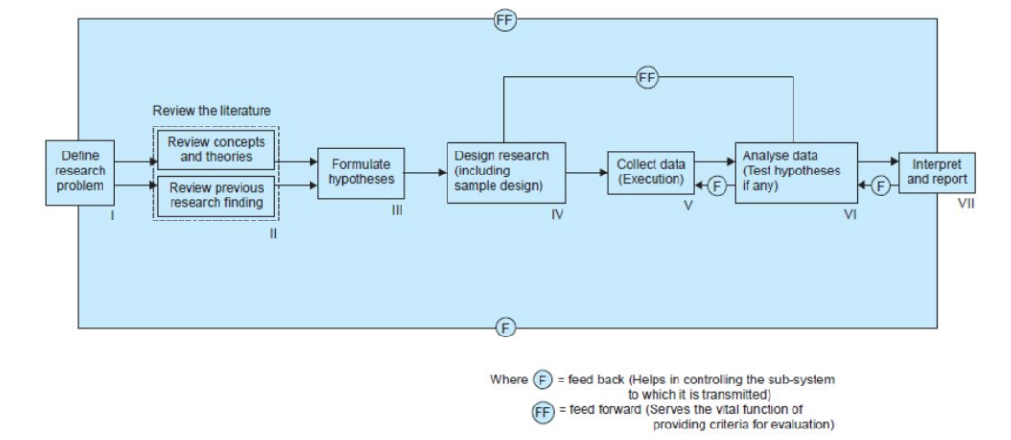

Slide 4
At times, the first step determines the nature of the last step to be undertaken. If subsequent procedures have not been taken into account in the early stages, serious difficulties may arise which may even prevent the completion of the study. One should remember that the various steps involved in a research process are not mutually exclusive; nor are they separate and distinct. They do not necessarily follow each other in any specific order and the researcher has to be constantly anticipating at each step in the research process the requirements of the subsequent steps. However, the following order concerning various steps provides a useful procedural guideline regarding the research process:

Slide 5
Formulating the research problem;
Extensive literature survey;
Developing the hypothesis;
Preparing the research design;
Determining sample design;
Collecting the data;
Execution of the project;
Analysis of data;
Hypothesis testing;
Generalizations and interpretation, and
Preparation of the report or presentation of the results, i.e., formal write-up of conclusions reached.

